Slide 1

Be a Pro in Your Home’s Kitchen
Marine Bruno
Richard Crippen
Will Hearn
Noah Hoback
Shawn Williams

Slide 2


Need to put together a dinner but don’t know where to start?
Are you in a rut where you’re cooking the same meals over and over, week after week?
Are you ready to up your game in the kitchen?
Want to blow your guests’ minds with delicious food, paired wines, and some fancy cocktails?
Look no further than Home Kitchen Pro.

Slide 3

Giving at home chefs a tool they can use to create both a food and a beverage experience.
The concept behind Home Kitchen Pro is simple - combine a meal with a wine and cocktail experience to help wow your guests.
We wanted to make an app that would give the users a place to get recipe ideas, pairable wines for each meal, and cocktail recipes.
I’ve always enjoyed cooking and entertaining in my home. I’ve not always been great with picking out wine and if a cocktail requires more than the mixer and liquor... you can count me out for making a cocktail. It is just intimidating.
We felt that if the user’s recipe research for a meal included both a pairable choice of wines as well as a cocktail for the evening - then readers may be more inclined to incorporate these things into their dining experience.

Slide 4

Process
Breakdown of Tasks and Roles
Project Manager – Richard
HTML/CSS – Marina and Richard
JS – William, Noah, and Shawn
Technologies Used
HTML
CSS
JavaScript/Query
Programming Language
APIs
Challenges
Changing from a gardening app to a wine and recipe app after a week’s effort.
Searching for appropriate and limited restriction APIs (in a sea of APIs).
Deployment of API
Successes
Got the second site idea to work.
Site design is close to sketched out framework.
Limited sacrifices in app’s concept and deliverables.
Adaptability
Diversity in members’ abilities and contributing strengths into project completion.

Slide 5

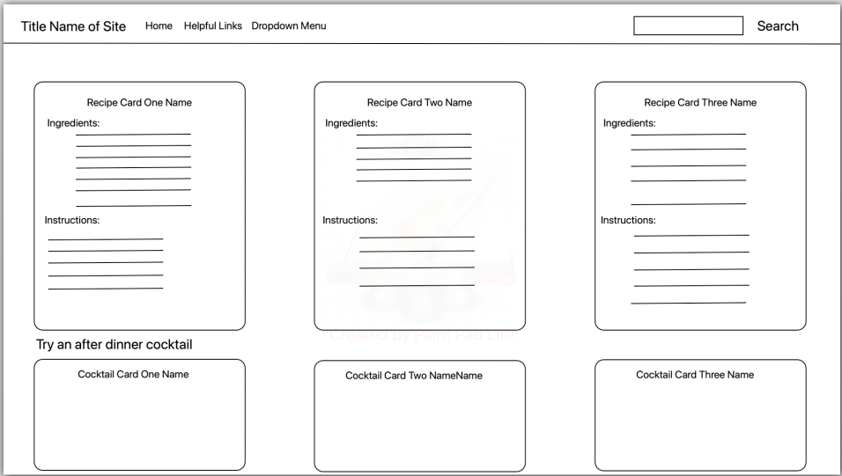
Framework

Slide 6
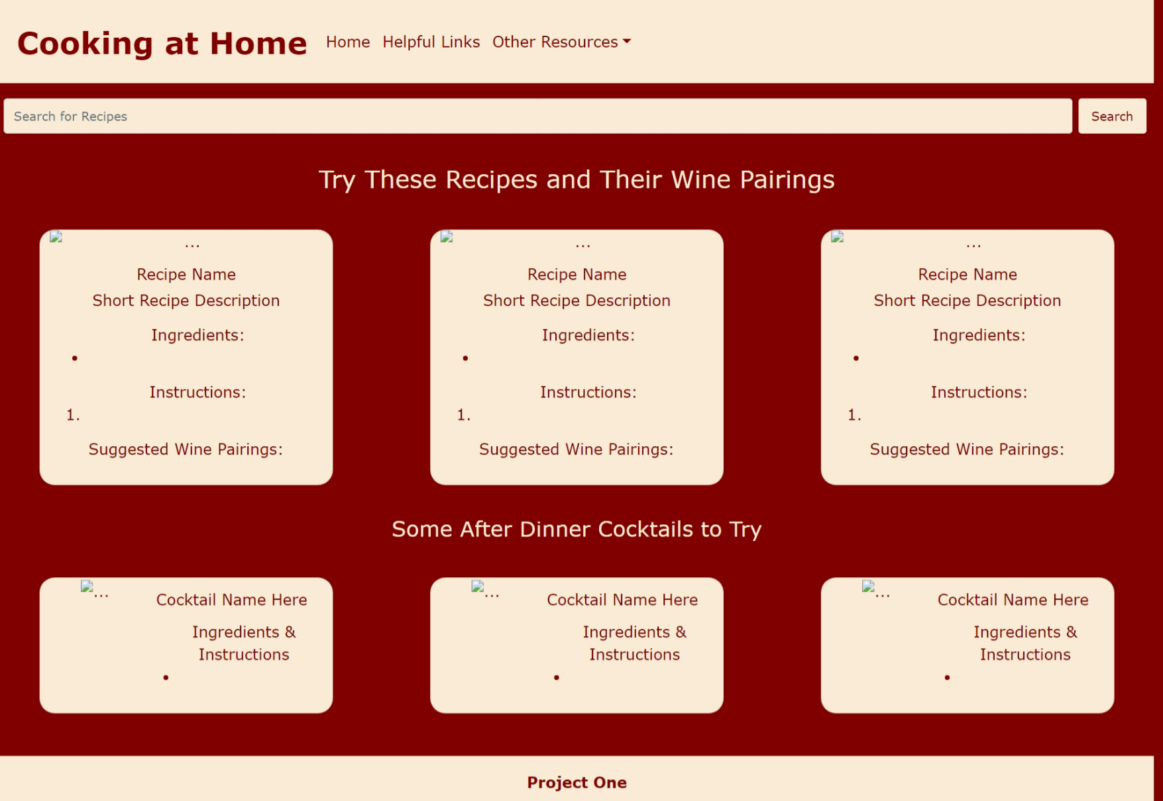

Initial Deployment

Slide 7
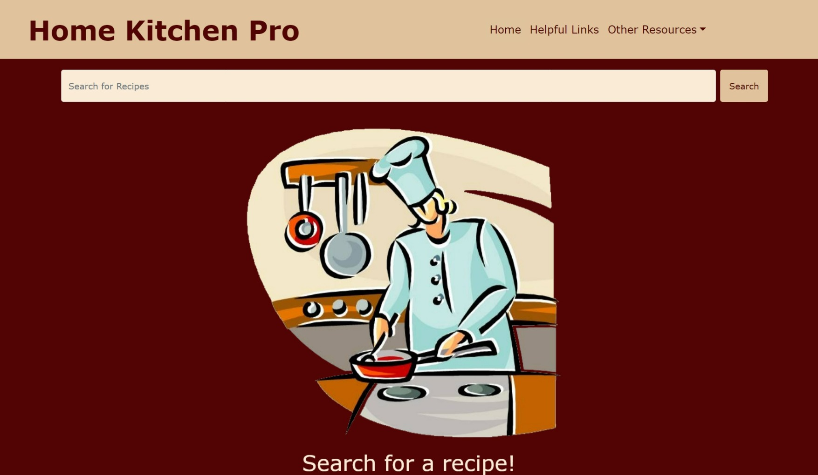
DEMO TIME!!!!!

Slide 8
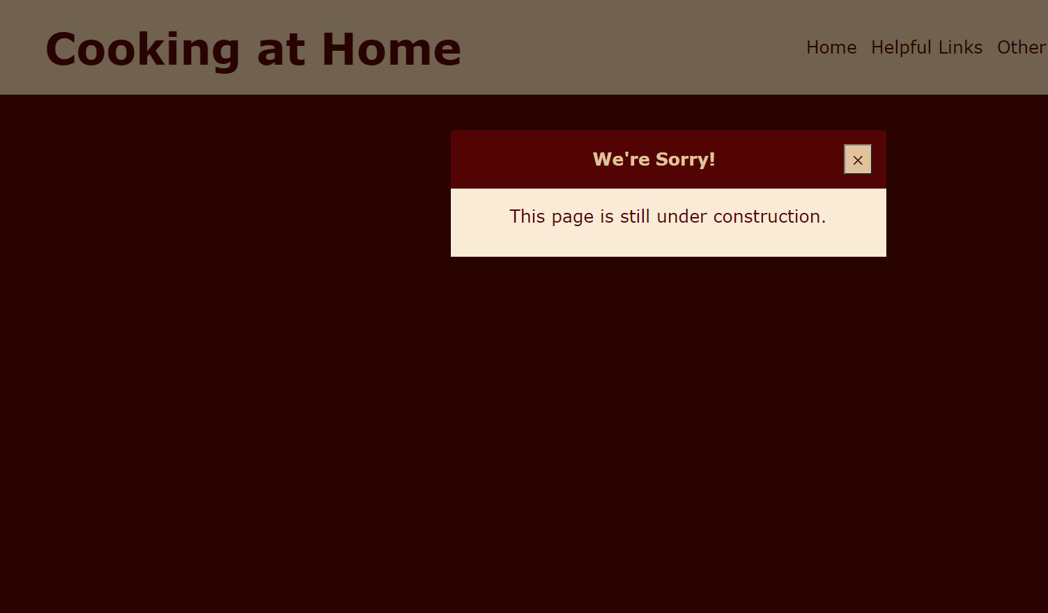
Directions for Future Development
The site will feature:
Helpful Links – This will feature unique links for improving cooking, wine vendors, cookware, etc.
Trending Recipes – This area will show recipes that are popular for users that week, month, and give users the opportunity to rate recipes.
Popular Wines – Great for wine tasters. This section will feature wines based on their interest and new wines that may peak their taste buds.
Tips of Entertaining at Home – Don’t always know what to cook when having guest. This section will take the guess work out of that.
Cocktails and Appetizers – Looking for a nice social spread with someone special or close friends. You can find what
Incorporating APIs that will show wines that pair well with recipe selections.
Additional APIs and coding that will widen recipe selections.

Slide 9
Links
Deployed App
https://rickyonthephone.github.io/Project1Repo/
GitHub Repo
https://github.com/rickyonthephone/Project1Repo.git
API
https://cocktailsapi.xyz/
https://spoonacular.com/food-api

Slide 10
Conclusion
This site will turn any home cook into a wizard among at home chefs. With recipes and wine selections that span cuisines from across the world. We guarantee you will find something that will satisfy the vegans, vegetarians, or carnivores dining with you. This app has multiple cuisines and recipes that can accommodate for different dietary restrictions. Easily, this app will become the next home tool that people would not want to be without. With future features to expand cooking abilities, wine taste profile, and more. It’s the home assistance that you always knew you need but couldn’t find until now.
Dine, Sip, and Unwind with Home Kitchen Pro.

Slide 11


QUESTIONS

